Slide 1
POV project
Daniel Gonzalez Gonzalez A01280648
Jose Luis Carvajal Carbajal A01280704
Jorge Armando Vazquez Ortiz A01196160

Slide 2
Introduction
The base idea of this project was a Vietnam landscape.
The reason we choose it was because it contained all the required elements.
Notes:
•Briefly describe your scene
•Give background information
•Describe your motivation for choosing such scene
•Show your inspiration

Slide 3
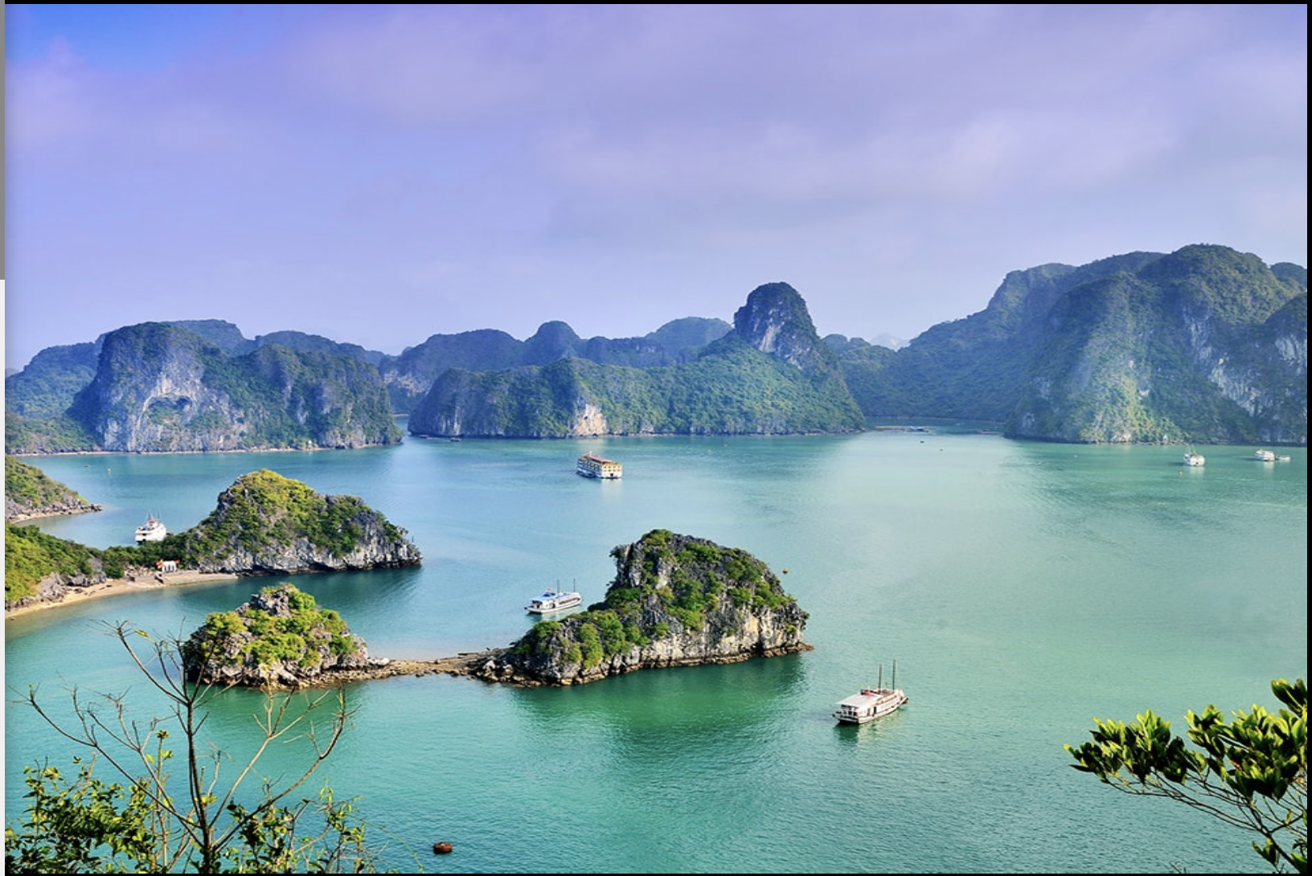

Slide 4
Modeling and Layout

Slide 5
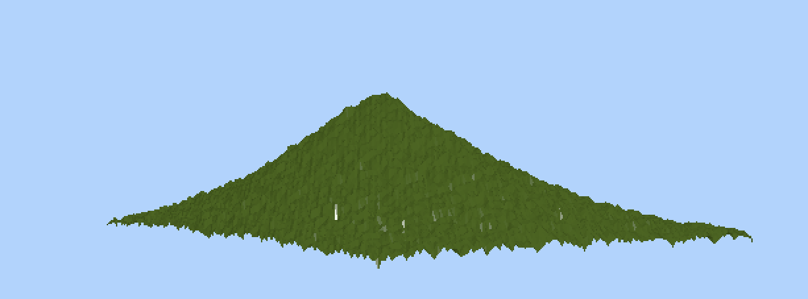
Original Models - Mountain

Slide 6

Ocean

Slide 7
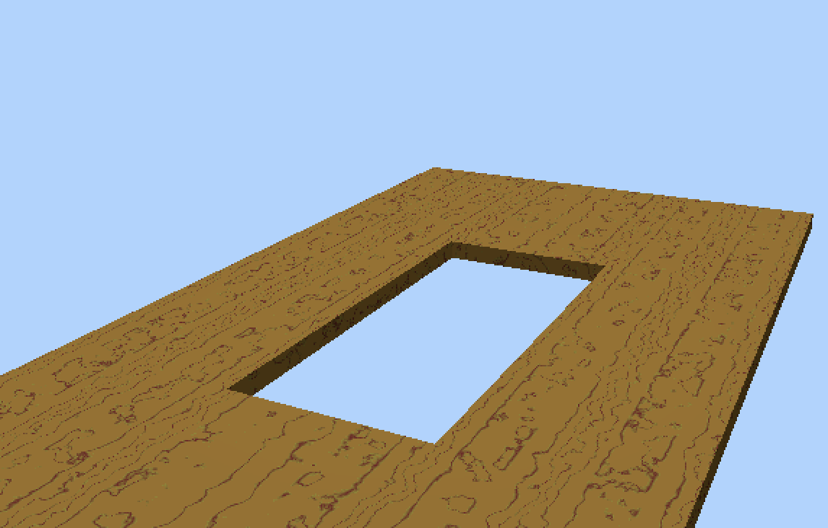

Pool

Slide 8
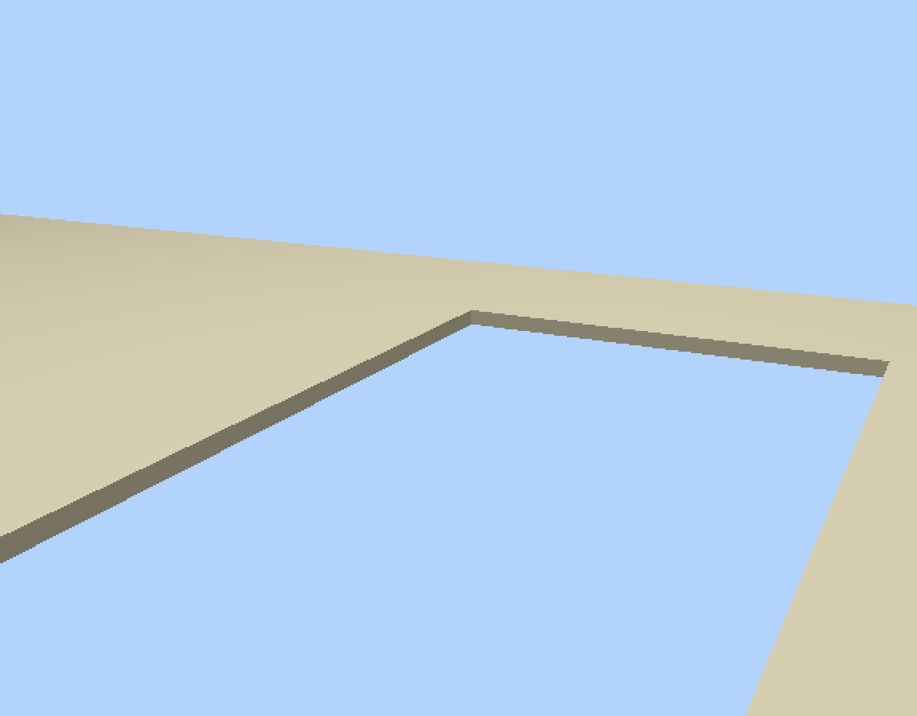
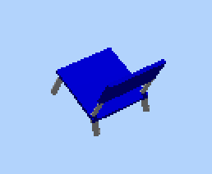
Sand and Chair

Slide 9
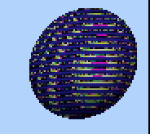
Moon with fractal

Slide 10
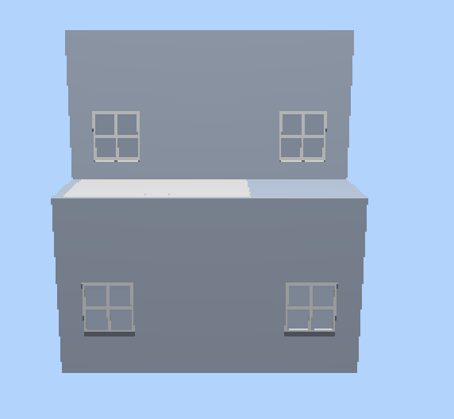
Penthouse

Slide 11

Imported Models - Beach Ball
Notes:
List Imported models
•State imported models origin

Slide 12
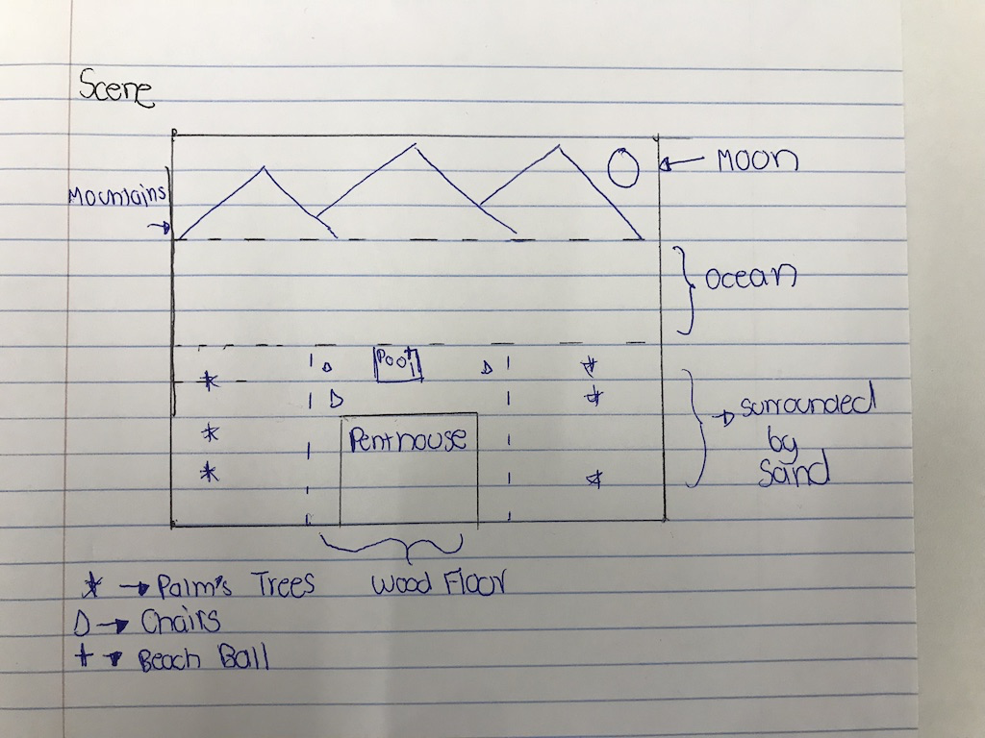
Layout and Composition
Notes:
•Describe your general Layout
•For the most important objects, describe why their are placed in the scene in such way

Slide 13
Fractal terrain

Slide 14
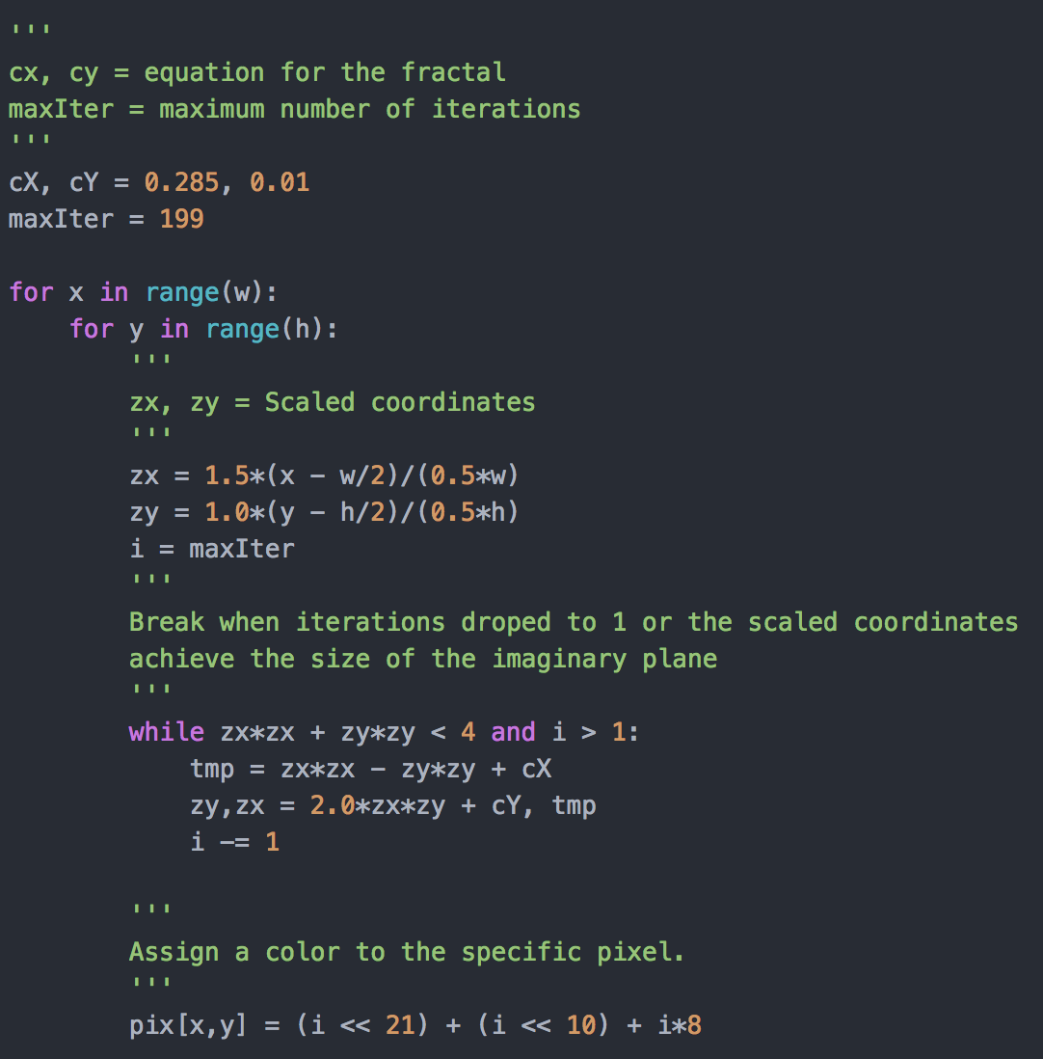
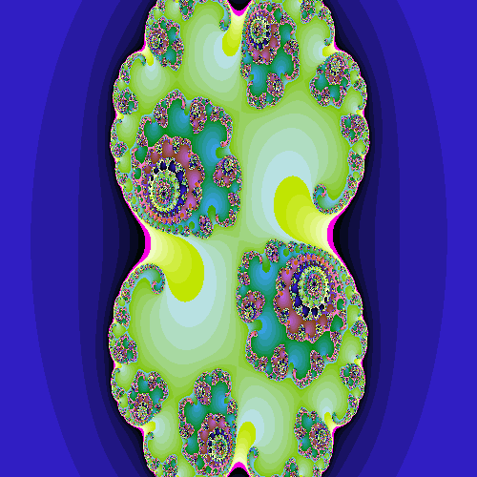
Fractal

Slide 15
Principles of Realism

Slide 16
Clutter and chaos - Palm trees
Believability - Most objects are easily identify due to similarity to their real life representation.
Radiosity: Light on ocean fades

Slide 17
Textures and Color

Slide 18
Textures
Water
Dark_Wood
Variations of colors
Notes:
•List models developed by the team
•Briefly, describe the procedure to generate the objects you feel more strongly about

Slide 19
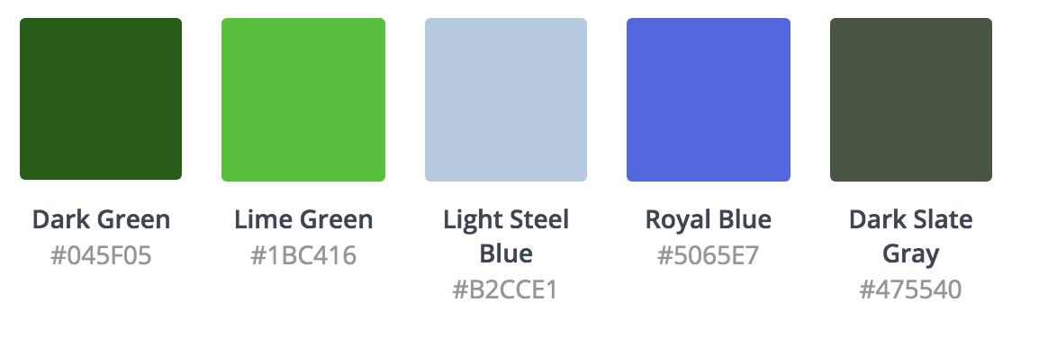
Color Palette
Notes:
•List models developed by the team
•Briefly, describe the procedure to generate the objects you feel more strongly about

Slide 20
Illumination & Cameras

Slide 21
Illumination
The light source of this image comes from a point located at the top of the scene with a white color.
Notes:
•Describe the illumination scheme
•Describe why you chose such illumination scheme

Slide 22
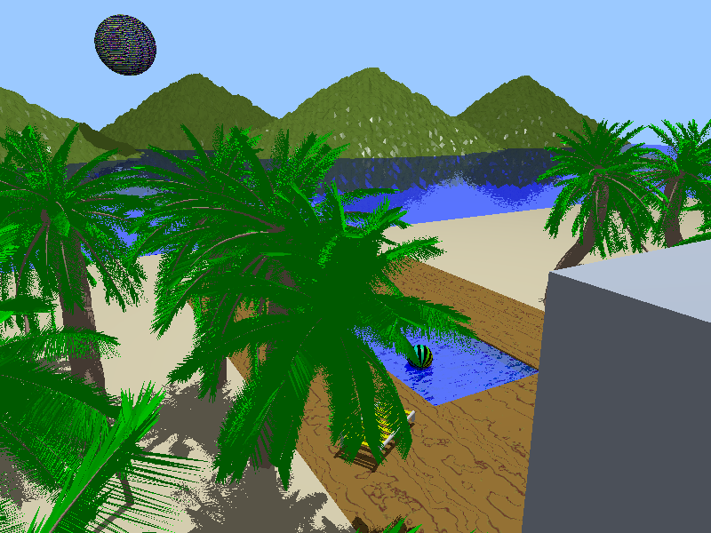
Cameras – Mountain_Left
This view captures one type of the palm trees as well as some of the mountains and the yellow chair.
Notes:
•Describe your camera setup
•For each camera, describe the type of scene you are creating (closeup, reverse, pov, etc), the lenses and the aspect ratio (width vs height)
•Describe why views are interesting
•Discuss if shadows give you more realism

Slide 23
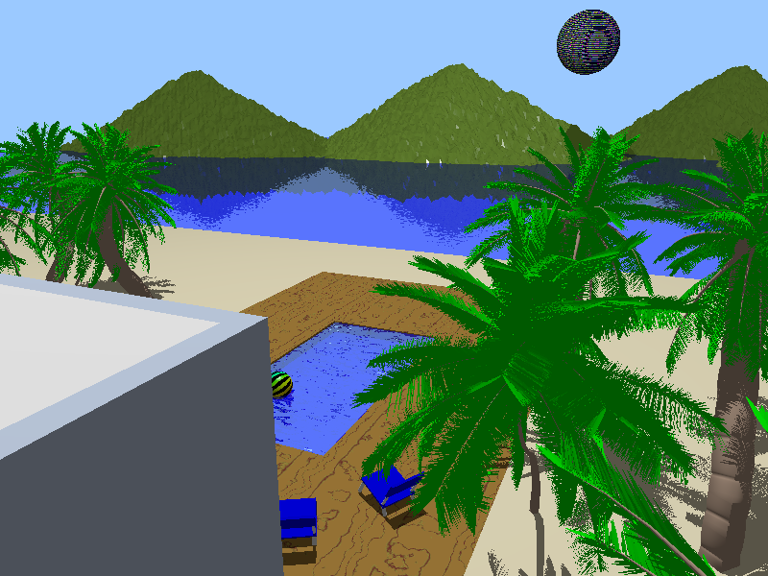
Cameras – Mountain_Right
This view captures other types of palm trees as well as another perception of other mountains and the moon, the blue chairs and the beach ball on the pool.
Notes:
•Describe your camera setup
•For each camera, describe the type of scene you are creating (closeup, reverse, pov, etc), the lenses and the aspect ratio (width vs height)
•Describe why views are interesting
•Discuss if shadows give you more realism

Slide 24
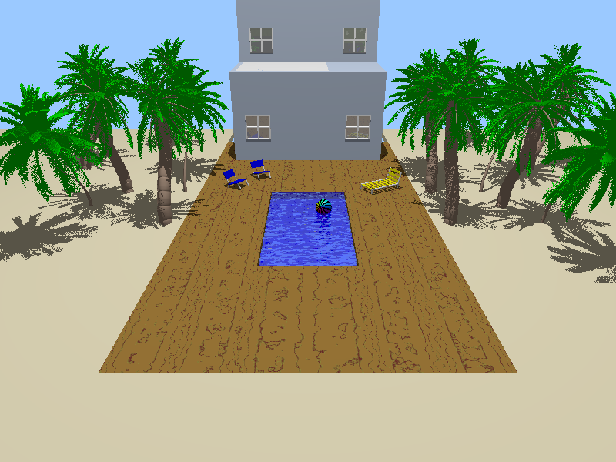
Cameras – House
This view captures the back part of the house where we can see the reflection on the windows and a better perspective of the pool and the trees.
Notes:
•Describe your camera setup
•For each camera, describe the type of scene you are creating (closeup, reverse, pov, etc), the lenses and the aspect ratio (width vs height)
•Describe why views are interesting
•Discuss if shadows give you more realism

Slide 25
Conclusions

Slide 26
Research
We investigated how to make a realistic sky and lake. As a result of the investigation we found out that there is an object “sky_sphere” which shows an sky in the environment and also we discovered the right properties to have a nice lake.
Also, from the Julia fractal approach we saw how a small arbitrary change can create a drastic change in the sequence, making it more chaotic.

Slide 27
Technical conclusions
The hardest challenge we faced was setting up the fractal. We had to make a research on how to make a Julia fractal and understand the conditions inside the code.
Notes:
•Discuss technical issues you encountered
•Describe important facts, actions and observations
•Discuss additional thoughts about the project

Slide 28
Ethical conclusions
For this project we tried to write most of code and when needed code from other sources we referenced.
Notes:
•Discuss how your project relates to our responsibilities as a professionals
•If you wish, discuss how you project relates to human morality

Slide 29
Citizenship Conclusions
The things we learn making this project can help us develop work for communitarian groups, such as NGOs.
Notes:
•Discuss how the project relates to your immediate community

Slide 30
Environmental Conclusions
The development of this project made us realize the importance of this project to generate environmental friendly models.
Notes:
•Discuss how your project relates to our responsibilities for our environment
•Also discuss further thoughts you may have

Slide 31
Executive Summary
Modeling:
The models that we used on this project were elements that we see in a daily basis which resembles the realism. Such elements include a house, moon, pool, sand, trees and mountains.
Fractals are used to create an image which is displayed in the moon. The code is presented in the slides.

Slide 32
Executive Summary - cont.
Illumination and Cameras:
A single light source was used to create the effect of a sun which gave interesting shadows to the models.
3 Cameras were used which gave 3 different perspective of the scene.

Slide 33
Bibliography
Lohmüller, F. A. (2006). House. Retrieved March 22, 2018, from www.f-lohmueller.de/pov_tut/x_sam/sam_110e.htm &cd=1&hl=en&ct=clnk&gl=mx
Perle, C. (1999, February 01). Downloading of sat1ball.zip. Retrieved March 23, 2018, from http://objects.povworld.org/objects/cgi-bin/dl.cgi?sat1ball.zip

